Slide 1


DATA MINING TECHNIQUES FOR CANCER DISEASE DIAGNOSIS AND PROGNOSIS
By TANUJA REDDY
MALIGIREDDY

Slide 2
Data Mining in Healthcare
Data mining is a multidisciplinary field at the intersection of database technology, statistics, ML, and pattern recognition that profits from all these disciplines
Data mining in healthcare are being used mainly for predicting various diseases as well as in assisting for diagnosis for the doctors in making their clinical decision
Data mining based on clinical big data can produce effective and valuable knowledge, which is essential for accurate evaluation of treatment effectiveness and risk assessment

Slide 3
Breast Cancer
Breast cancer is one of the many types of cancers that have been diagnosed in humans. It is majorly detected in the females as compared to the males
The second leading cause of death among women is breast cancer, as it comes directly after lung cancer.
Breast cancer considered the most common invasive cancer in women, with more than one million cases and nearly 600,000 deaths occurring worldwide annually.

Slide 4
Classification Techniques
Building accurate and efficient classifiers for large databases is one of the essential tasks of data mining and machine learning research
The ultimate reason for doing classification is to increase understanding of the domain or to improve predictions compared to unclassified data.

Slide 5
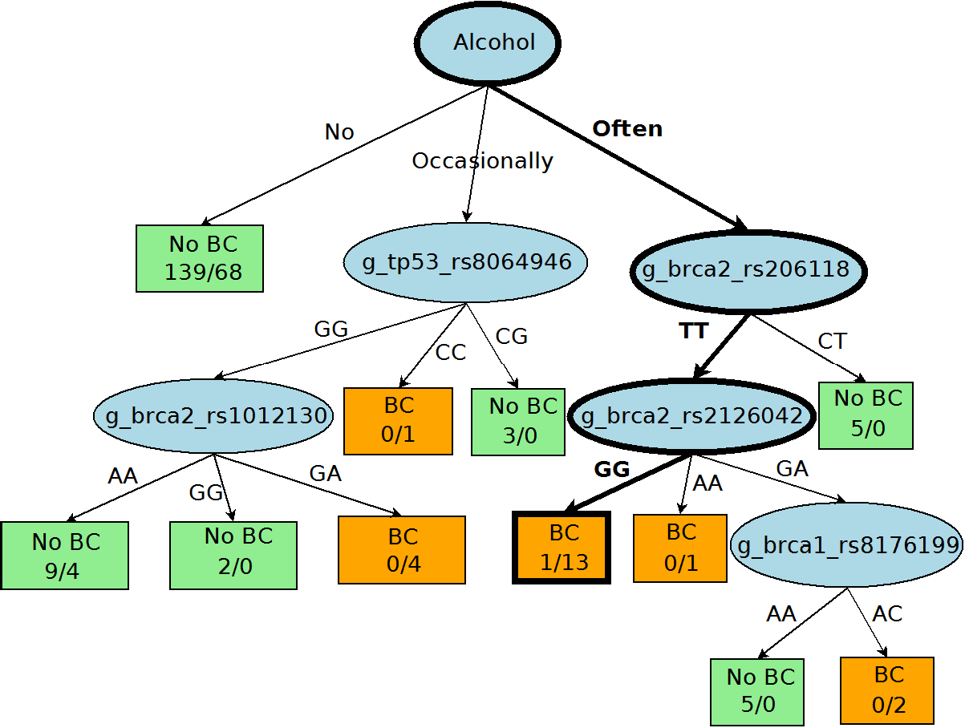
Vulnerability to developing breast cancer: Decision Trees
Decision trees are a classification technique that uses a tree-like structure to analyze decisions, possibilities, consequences, and measures.
A case-control research was conducted to investigate the applicability of decision trees in identifying a group with a high risk of developing breast cancer.
Alcohol and smoking data is used which contains 164 controls and 94 patients with 32 SNPs from the BRCA1, BRCA2, and TP53 genes
Setting correlation coefficient as 0.8, the data has been narrowed down to 32 SNPs with selected cases from each gene category.
The experiments are carried out with Weka J48 and C4. 5 decision trees are produced using 10-fold cross validation

Slide 6
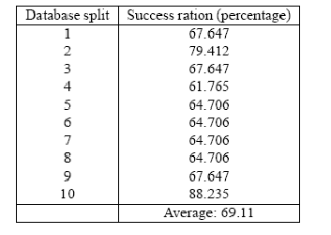
Digital Mammography Classification using Association Rule Mining
A mammogram is an x-ray picture of the breast. Mammograms can be used to check for breast cancer in women
Association rule mining is used analyze data for patterns, or co-occurrences, in a database. It identifies frequent if(an antecedent)-then(a consequent) associations, which themselves are the association rules.
The apriori algorithm is used to find association rules between the features with the antecedent being the features and the consequent being the category.
The association principles are utilized to create a classification system that divides mammography into normal, malignant, and benign with confidence at 0%, and support at 10%

Slide 7
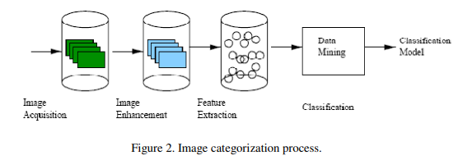
Digital Mammography Classification
Mammograms can be performed to check for breast cancer
While analyzing the mammograms during the experiments
the ones that are abnormal are further divided into six
categories: microcalcification, circumscribed masses,
spiculated masses, ill-defined masses, architectural distortion,
and asymmetry.
Two Image Enhancement techniques: a cropping operation and an image enhancement have been performed before feature extraction.
After feature extraction, the extracted features are calculated over smaller windows of the original image.

Slide 8

Association rule based Classifier
The apriori algorithm to find the association rules in the database, with the antecedent being the features and the consequent being the category
The association principles are utilized to create a classification system
that divides mammography into normal, malignant, and benign.
The confidence was set at 0%, and the support at 10%. The association rule classifier had an average success rate of 69.11%.
Success ratios of association rule-based classifier using 10 splits

Slide 9
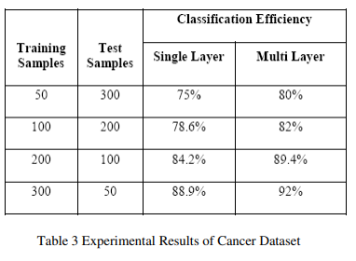
Neural Network based classifier system
Three layers make up the neural network architecture: an input layer,
a hidden layer, and an output layer. The output layer node provides
the classification for the image.
By implementing parallelism for the output calculation at each node
in the various levels of the network, Neural Networks Parallelization
Strategies are employed in this to produce effective results.
The dataset contains 10 plus class attributes and 669 instances
where each instance has two possible classes benign and malignant. Taking into consideration various attributes and their domains, it is proved that the neural networks technique provides satisfactory results for the classification task.

Slide 10
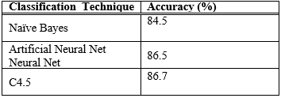
Prognosis of Breast Cancer Patients’ Survival Rates: Naive Bayes Classifier
Based on analysis of three data mining techniques — Naive Bayes, back-propagated neural network, and C4.5 decision tree algorithms — used to predict the survivability rate of breast cancer patients in a newer version of the SEER database with two additional fields — Vital Status Recode (VSR), and the Cause of Death (COD) it is found that C4.5 algorithm has a much better performance than the other two techniques.
Accuracy of Cancer Dataset

Slide 11
Support Vector Machines and Logistic Regression
The main goal is to use data mining techniques to try to identify breast cancer patients for whom treatment increases survival time. Based on the study, the 6-feature space consists of one pathology feature and five cytological features.
Based on our analysis of the survival curve, these findings imply that patients in the Good group shouldn’t take chemotherapy, but those in the Intermediate group should.
Logistic Regression: The final dataset, which had 202,932 records and 17 variables, was created after employing these data preparation and cleaning techniques.
Classification accuracy, sensitivity, and specificity were used to evaluate the models
The logistic regression model had a classification accuracy of 0.8920, a sensitivity of 0.9017, and a specificity of 0.8786.

Slide 12
Poor Prognosis and Good Prognosis: Bayesian Networks
An interface is created for the radiologists to engage with the project’s Bayesian network learning algorithm in experiments to deploy the Bayesian Belief Network for automated breast cancer detection support tools and computer-aided detection in mammography.
The publicly available data on breast cancer patients is afterward divided into two prognostic groups by combining clinical and microarray data.
The prognosis for lymph node-negative breast cancer is what is being predicted. A bad prognosis is one in which the disease returns within 5 years of diagnosis, whereas a good prognosis is one in which at least 5 years pass without the presence of the disease.

Slide 13
Conclusion and Future Work
Decision tree is determined to be the best predictor among the various data mining classifiers and soft computing techniques, with 93.62% Accuracy.
The predictor can be used to create a web application in the future that will accept the predictor variables and automated method.
The Bayesian network has proven to be a successful method for medical prediction, particularly for the diagnosis and prognosis of Breast cancer. In the future, this framework can be used to build web-based apps.

